Slide 1

Grimbeek Update
October 6, 2017

Slide 2
Tentative schedule for the next conference call:
October 11, 2017 at 15:30 Buenos Aires time (1:30 pm Austin)
Try use zoom for our next call as we have results to discuss
Zoom Meeting (only when sharing monitor)
Join from PC, Mac, Linux, iOS or Android: https://zoom.us/j/152334885
Or iPhone one-tap (US Toll): +14086380968,152334885# or
+16465588656,152334885#
Or Telephone: Dial: +1 408 638 0968 (US Toll)
+1 646 558 8656 (US Toll)
+54 341 512 2188 (Argentina Toll)
Meeting ID: 152 334 885
Freeconferencecall.com
Argentina: dial +54 341 527-2974 then 583857# (include the pound sign)
US: dial 641-715-0700 then 583857# (include the pound sign)

Slide 3
Field and Project Status
-10 years primary recovery
-started full field waterflood (secondary recovery) in Jan 2012
-ongoing polymer flooding in designated pilot area since April 2015 until late 2017 (amount injected based on simulation results)
-15-acre pattern at 400 m³/day (2,500 bbl/day injection into 4 wells)
-plan to continue with chemical pilot as soon as reasonable chemical formula/design available (aiming at early 2018)
-ASP and SP formulation have been developed
-2 outcrop ASP and 1 outcrop SP corefloods are done
-2 reservoir coreflood: pending YPF economic evaluation and discretion

Slide 4
Summary
Previous Discussion Points
UEORS suggest periodic produced brine sampling and analysis
ACP does not produce low IFT emulsion at proper flooding design, shift focus to ASP
ASP vs SP
majority of injection facilities are there because of the ongoing polymer pilot
minimize investment needed to implement the next step of CEOR after polymer
SP-modification in the current facilities are minimum
ASP-need softening facilities or additional chelating agent
ASP-need alkaline facilities (safety may be complex in this case; it may take long times for approval)
Typical alkali benefits: less retention, faster equilibrium, less cosolvent
Alkaline concentration above 1% has an impact in the economics (logistics/storage are also complicated)
YPF declined UEOR proposal for economics evaluation; will do own economic calculation

Slide 5
Summary (cont’d)
Previous Discussion Points
Harcros as a to go chemical supplier (~$2/lb for multi-million pound scale)
Univar as the to go chemical distributor
Get cost for water softening source
Get scale based pricing,
~1000 lb scale for single well test
200,000 lb scale for pilot scale
Multi-million pound scale
ASP formulation performed well in outcrop ASP coreflood tests
Formulation development extended for SP evaluation (approved on Feb 10, 2017)
SP outcrop coreflood test requested Jun 2, 2017)

Slide 6
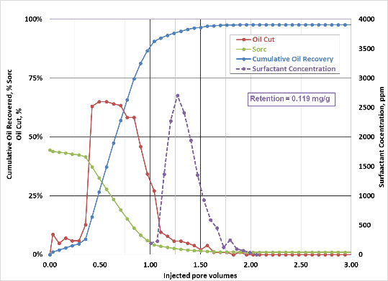
Summary (cont’d)
Previous Discussion Points
Outcrop ASP coreflood 1 (top graph)
was successful
Low residual oil saturation (S_{or}=~1%)
Good pH and viscosity propagation
Low surfactant retention (0.12 mg/g rock)

Slide 7
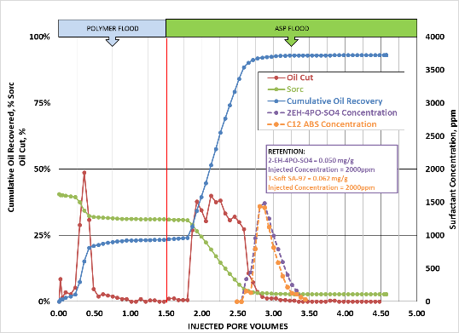
Summary (cont’d)
Previous Discussion Points
ASP after polymer flood (outcrop ASP
coreflood 2) was successful
Low residual oil saturation (S_{or}=~3%)
Good pH and viscosity propagation
Low surfactant retention (0.11 mg/g rock)

Slide 8
Update
This Week Discussion Points
ASP formulation
0.9% total chemical: 0.2% 2EH-4PO-sulfate, 0.2% T-Soft SA-97 (light ABS), 0.5% UEOR Y0105N (IBA-1PO-5EO)
optimum at ~1% Na₂CO₃ in ~11,500 ppm injection brine
optimum drop to 0.25% Na₂CO₃ for 0.45% total chemical
Either use softened brine or add min. 1500 ppm of Na₄EDTA.2H₂O EDTA to hard brine (for $1/lb EDTA add ~37 cents cost per lb surfactant)
1.5% Na₂CO₃ injection salinity
0.25% Na₂CO₃ injection polymer drive
SP formulation (with hard injected brine; no water treatment beyond filtering):
1.15% total chemical: 0.52% Enordet O242 (IOS C_{20–24}), 0.48% UEOR315 (C28-35PO-15EO-sulfate), 0.15% UEOR Y0105N (IBA-1PO-5EO)
optimum at ~1.75% NaCl in ~11,500 ppm injection brine
1.75% NaCl injection salinity
1.75% NaCl in preflush and 0–1% NaCl in polymer drive
SP after polymer flood was successful
Low residual oil saturation (S_{or}=~5%)
Good viscosity propagation
Low surfactant retention (0.23 mg/g rock)
Notes:
Different mechanism of retention
Additional surfactant retention because unfovarable mobility ration (phase trapping)

Slide 9
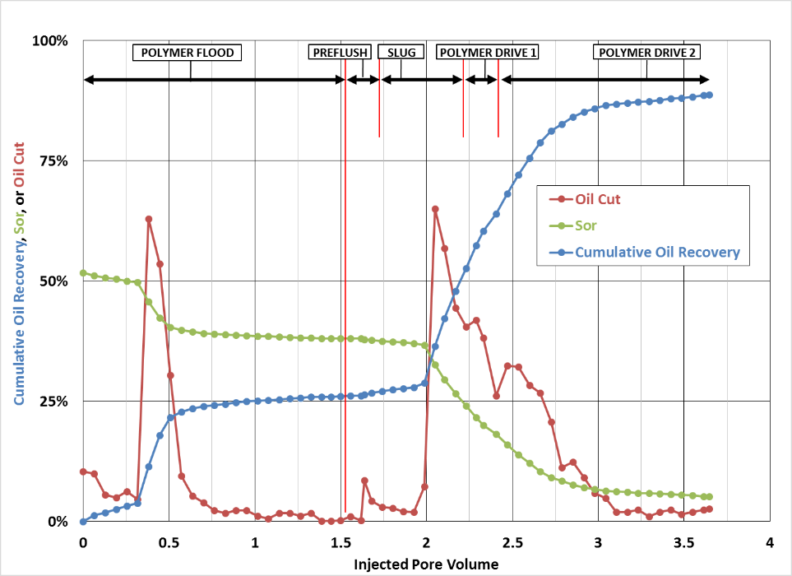

Slide 10
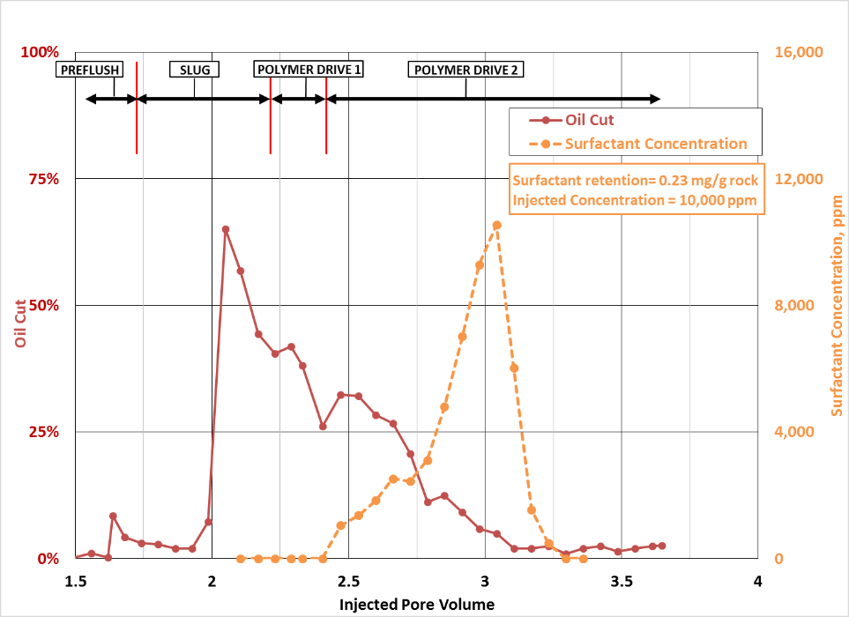

Slide 11
Update
This Week Discussion Points
CEOR pilot with 400 m³ injection rate
0.9% chemical (ASP)
~ 8,000 lb/day or
~320,000 lb total in 1.33 month (0.25 PV for 1 acre pilot) 1.5 usd/lb just surfactant cosolvent 1.1 usd/lb
~2,900,000 lb/year (0.15 PV/year for 15 acre pilot)
1.15% chemical (SP)
~ 10,200 lb/day or
~404,000 lb total in 1.33 month (0.25 PV for 1 acre pilot)
~3,700,000 lb per year (0.15 PV/year for 15 acre pilot)
1.5 usd/lb + 1.1 usd/lb
Detailed data on ASP and SP outcrop corefloods are sent
Plan for 2 reservoir corefloods, which priority:
pending internal YPF economic evaluation and simulation
polymer flood (as is pilot) followed by (A)SP vs direct (A)SP
(A)SP vs. (A)SP with concentration optimization

Slide 12
Rough Assumption
ANY FORMULA AND CONCENTRATION IS NOT FINAL
FOR PRELIMINARY ECONOMIC CALCULATION ONLY
ASP with hard water vs SP
(Assumed polymer injection at pilot tapered to 200 ppm)
Tentative pilot chemical slug formula (0.5 PV):
0.4% surfactant, 0.5% co-solvent 1% surfactant, 0.15% co-solvent
1500-4000 ppm EDTA no EDTA
11,500 injection brine + 1.5% Na₂CO₃ 11,500 injection brine + 1.75% NaCl
4000 ppm polymer (~100 cP) 4300 ppm polymer (~100 cP)
Example polymer drive composition (coreflood, pilot and full field)
2500 ppm polymer 2500 ppm polymer
0.25% Na₂CO₃ ~0% NaCl
Field injection assumption:
Chemical concentration
0.9% total chemical 1.15% total chemical
0.2% EDTA no EDTA
1.5% Na₂CO₃ 1.75% NaCl (with salinity preflush) 0.2 pv
3500 ppm polymer 3800 ppm polymer
Surfactant retention:
0.1 mg/g rock (assumed) 0.2 mg/g rock (assumed)
Slug size ~0.25 PV Slug size ~0.25 PV
Notes:
For raising accous salinity,
Optimun salinity narrow region 0.2 PV.
0.7 for ASP.
1.15 not much potention winoto saw in the phase behaviour.

